Slide 1
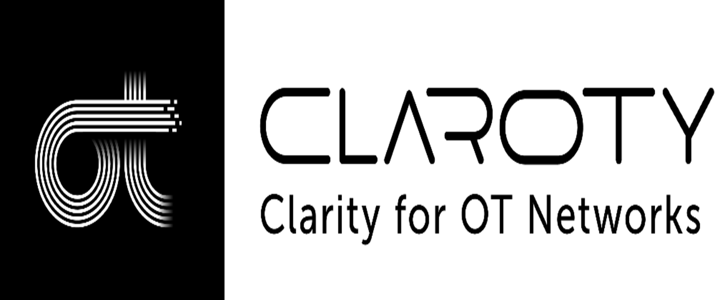


Slide 2
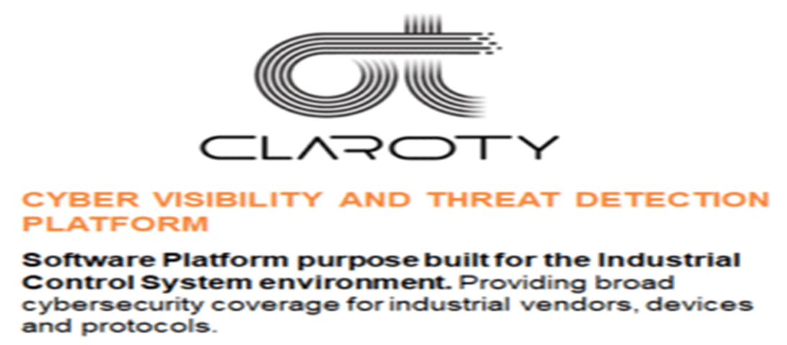
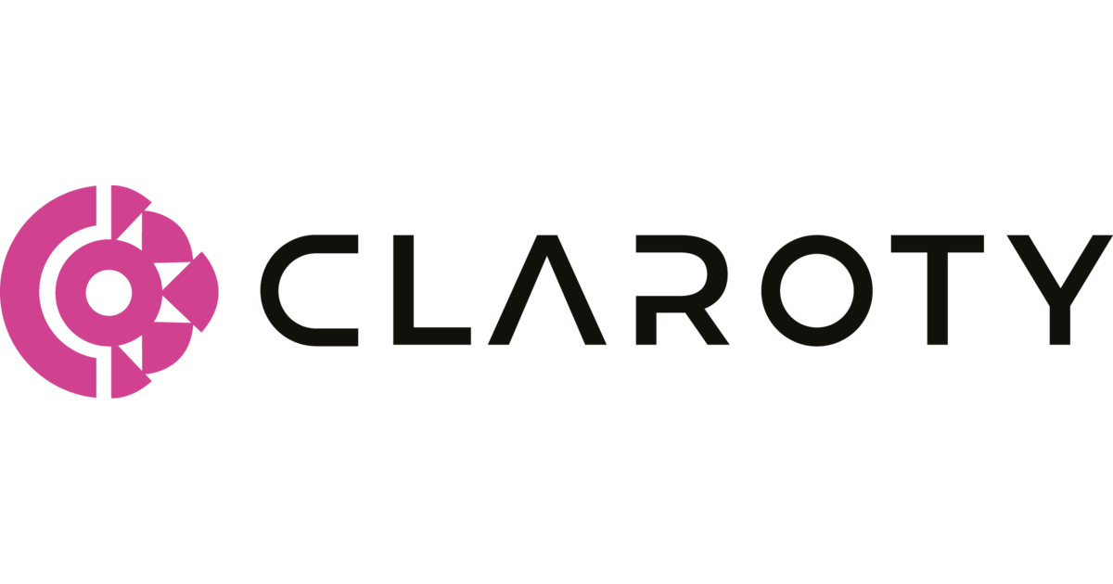
WHAT IS CLAROTY?
As per the Industrial Control Systems Architecture the Claroty works on the level-3 which is the bridge between IT and OT.

Slide 3
Vestibulum congue
Claroty xDome
Products of Claroty
Vestibulum congue
Claroty CTD
Vestibulum congue
Claroty Edge
Vestibulum congue
Claroty SRA

Slide 4
Key features of Claroty xDome and CTD(Continuous Threat Detection):
Extends Security across industrial all XIoT Devices
Desgined for Scalability, Flexibility and it is easy to use
1
3
2
4
Support all cybersecurity to your industry
Integrates Seamlessly with your existing tech stack

Slide 5
Key features of Claroty Edge
Builds the foundation for cybersecurity maturity
Requires zero network changes or hardware
1
3
2
4
Supports multi-disciplinary use cases
Offers unmatched time-to-value

Slide 6
Key Benefits of Claroty Secure Remote Access(SRA):
Streamlines Access for Internal and Third-Parties
Offers full Auditing and Response Capabilities
1
3
2
4
Extends Zero Trust-based Access Controls
Delivers a Ideal UX that reduces MTTR

Slide 7
Things that are offered by Claroty xDome and CTD:
Asset Discovery:
Discover any type of devices for providing security to it.
Vestibulum congue
Threat Protection:
Protections from any types of OT and IT threats that which damages Industrial products.
Asset Dsicovery
Things that are offered by claroty xDome.
Vestibulum congue
Vestibulum congue
Asset Management
Threat Detection
Vulnerability & Risk Management:
Detect the Vulnerability and Risk in the Devices and than fix or solve the Vulnerabilities and Risk to strengthen the network and secure it.
Network Protection:
Protection of the network and secure from the network threats.
Vestibulum congue
Vestibulum congue
Vulnerability & Risk Management
Network Protection
Asset Management:
Manage the Assets of the Industry.

Slide 8
Things that are offered by Claroty Edge:
Asset Discovery:
It can be used to discover new Assets and Devices in the network.
Incident Response:
It gives Incident notification of any of the threats and risk that take place in the industry.
Incident Response
Asset Discovery
Things that are offered by Claroty Edge
Vulnerability & Risk Management:
Detect the Vulnerability and Risk in the Devices and than fix or solve the Vulnerabilities and Risk to strengthen the network and secure it.
Audit, Compliance and Due Dilgence:
It offers the security and give Audit ,Compliance and also the Due Dilgence
Audit, Compliance and Due Dilgence
Vulnerability and Risk Management

Slide 9
Things that are offered by Claroty SRA(Secure Remote Access):
Remote Maintenance:
SRA offers highly secure, controlled, safe access no matter where users, facilities, or assets are located.
Remote Incident Management:
It gives continuous monitoring and enable to detect, investigate and respond to threat or incident.
Remote Incident Management
Remote Maintenance
Remote Access Administration:
With SRA, IT teams can delegate administration of remote access to plant staff without worrying about compromising security or infrastructure with help of static firewall protection and secure channel.
Things that are offered by Claroty SRA
Comprehensive Monitoring
Remote Access Administration
Role-Based Access Control:
It will give Role-control based access to the employees from providing more security to company.
Role-Based Access Control
Comprehensive Monitoring:
It provide limited monitoring and auditing capabilities to the user.

Slide 10
Prices of the Claroty and it’s products:
Description of Claroty products | Price of Products(in $) | Price of Products(in Rs.)
Price of Claroty and Claroty | $ 3,00,000 | Rs. 2,47,50,000
Price of Claroty Edge | $ 27900 | Rs.23,92,500
Price of Claroty SRA (extra small-size) | $ 3000 | Rs.2,47,500
Price of Claroty SRA( small-size) | $ 6000 | Rs. 4,95,000
Price of Claroty SRA(mid-size) | $ 9000 | Rs.7,42,500
Price of Claroty SRA( Large-size) | $ 13500 | Rs.11,13,750
Price of Claroty CTD(extra small size) | $ 5900 | Rs. 4,86,750
Price of Claroty CTD(small size) | $ 19500 | Rs. 16,08,750

Slide 11
Prices of the Claroty and it’s products:
Description of Claroty products | Price of Products(in $) | Price of Products(in Rs.)
Price of Claroty CTD(mid-size) | $ 29250 | Rs. 24,13,125
Price of Claroty CTD(Large-size) | $ 43875 | Rs. 36,19,688
Price of Claroty CTD(Very-Large size) | $ 65000 | Rs. 53,62,500

Slide 12
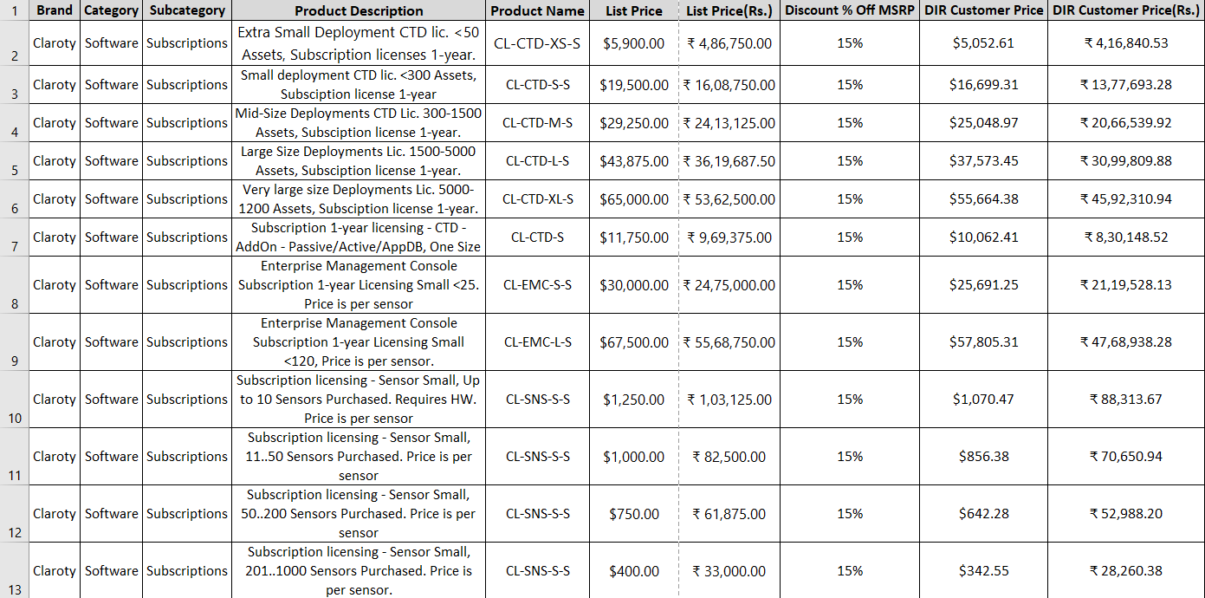
All Products Price list with discount prices in both ($ and Rs.)

Slide 13
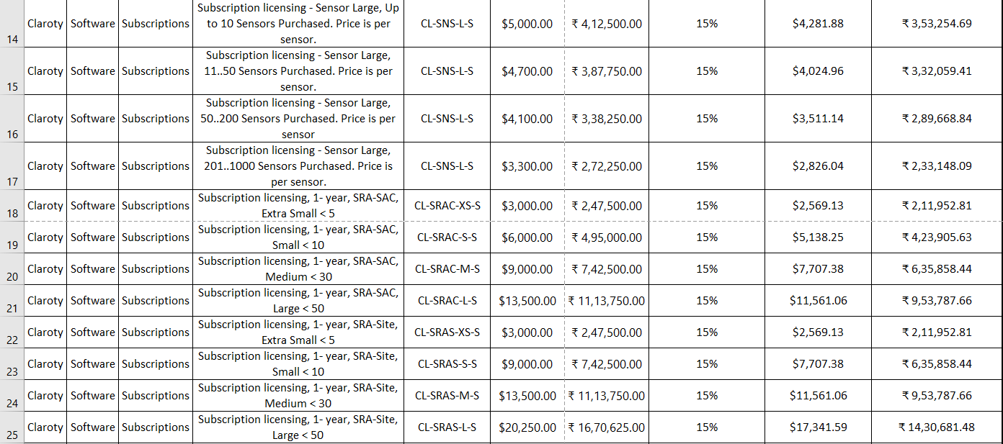

Slide 14
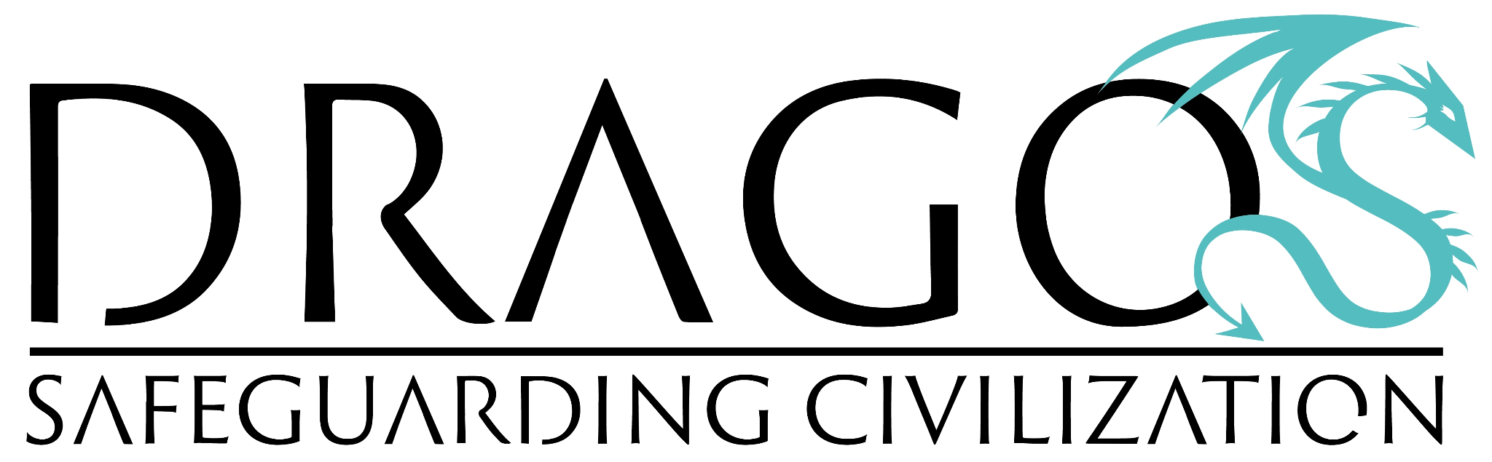
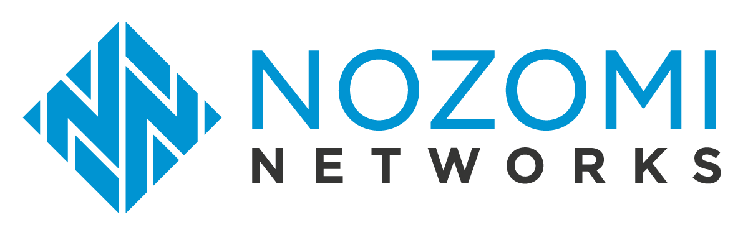

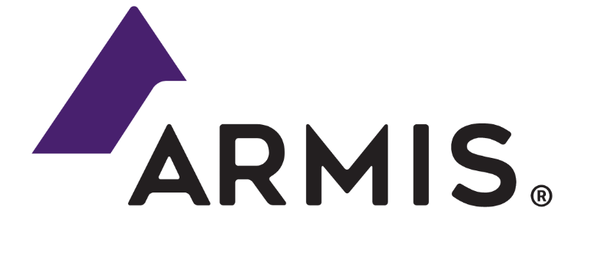

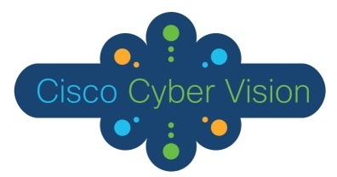
Competitiors of Claroty in the Market:

Slide 15
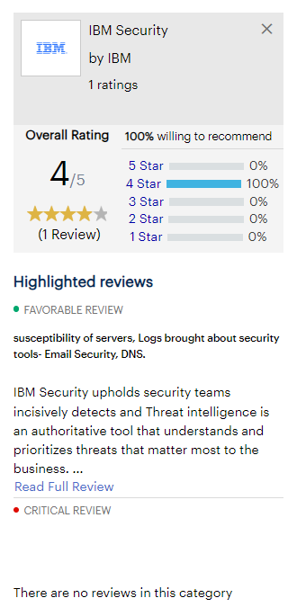
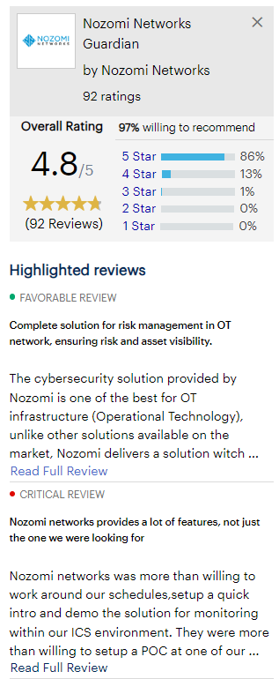
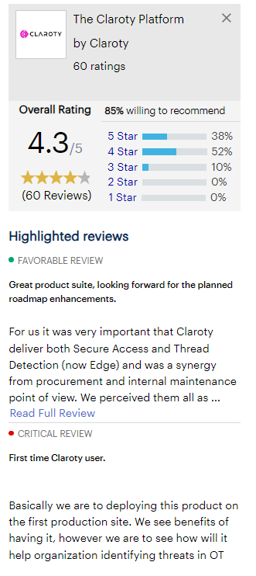
Comparison of all tools described in before slide:

Slide 16
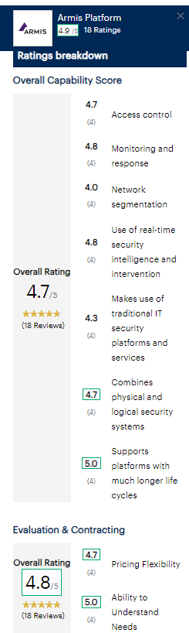
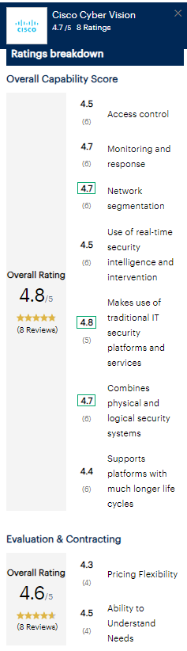
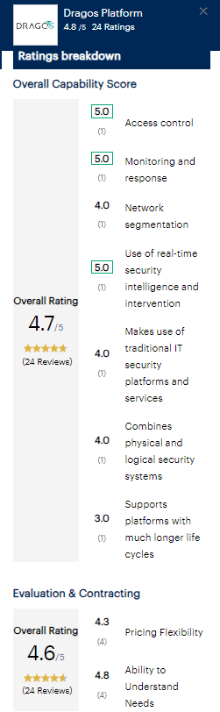

Slide 17
For more products comparison go to below give link:
https://www.gartner.com/reviews/market/operational-technology-security/compare/product/armis-platform-vs-cisco-cyber-vision-vs-dragos-platform-vs-ibm-security-vs-nozomi-networks-guardian-vs-the-claroty-platform#

Slide 18
Prices of the competitors of Claroty:
Price of Armis Platform: $ 50,000/month- Rs.41,25,000/month
Price of Nozomi Networks:
Lowest price: £52,747.20 - Rs. 46,75,512
Highest price: £7,384,608 - Rs. 65,45,71,653

Slide 19


